Slide 1


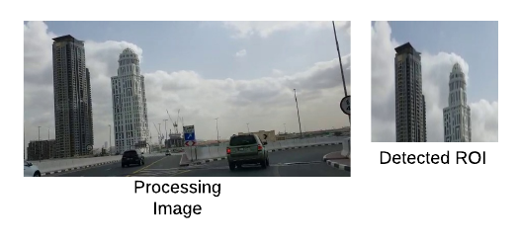
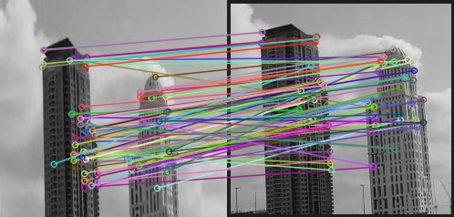
GPS Substitute For Buses Based On Image Recognition
Project by: Muhammad Maaz
Supervisor: Dr. Stephen Sangwine
About Project
In this project, the image recognition is used to track the location of a bus moving on a specific route, the main goal of the project is to look for ROI ( region of interest ) in a image and used the ROI to recognize the position of the bus.
Instance-level Recognition
This method of image recognition is mainly focused to match the object in the image, to execute this process an important procedure is to use image dataset which consisting object of interest. The process begins by detecting interesting points as well as key descriptor in a image subsequently attempts to match the predetermined object in a given query image.
Feature Extraction
Every image consist some essential information, to discover this information different techniques can be adopted, however the technique which is used in this project uses an algorithm which is known as ORB (Oriented FAST and rotated BRIEF), it uses Features from accelerated segment test (FAST) corner detection which extract key points then applies a Harris corner measure to find top number of corner points among them.
ROI Classification
Detecting the key point enables to classify the salient features in the image which can be used as area of region of interest.
Image Comparison
To distinguish the co-relation between two images and to locate the location of the image, the ROI detected in a previous step is compared by implementing three different approaches
•Template Matching - To search the ROI in the image, the template matching techniques is used which to find the template in full image.
• Feature Matching - once found the feature matching method
is used to match the key points of two same image.
• Structural Similarity is applied which measures the similarity ratio between two images.
ROI OF DETECTED FROM A FULL IMAGE
Matching Only Good Features
QUERY ROI
Found template in square

